Slide 1



Propagation Measurements and Analyses at 28 GHz via an Autonomous Beam-Steering Platform
Bharath Keshavamurthy*, Yaguang Zhang^, Christopher R. Anderson#,
Nicolò Michelusi*, David J. Love^, and James V. Krogmeier^
*Electrical, Computer and Energy Engineering, Arizona State University, Tempe, AZ
^Electrical and Computer Engineering, Purdue University, West Lafayette, IN
#Electrical Engineering, United State Naval Academy, Annapolis, MD

Slide 2




Motivation
Widespread 5G deployments using the mid-band spectrum
Operators have now shifted focus on to the mmWave spectrum
Enhancement in UX vis-à-vis data rates & latencies
Propagation challenges
Academic research has also gained a renewed emphasis
June 20, 2019
Nov 14, 2018

Slide 3
Features & Contributions: System Design
A fully autonomous V2X* mechanical beam-steering platform^{[1]}
Cost- & computationally-effective vs electronic beam-alignment strategies^{[2]}
The principal axes positioning accuracy = 1.1º
The beam-steering response time = 27.8 ms
3-D geo-positioning accuracy of 17 cm with real-time kinematics
Real-time route visualizations via Plotly-Dash/MapBox
Real-time sample visualizations & efficient data storage (with redundancy)
* Can be easily scaled to double-directional measurements and MIMO operations
[1] M. Comiter et al., “Millimeter-wave field experiments with many antenna configurations for indoor multipath environments,” in 2017 IEEE Globecom Workshops (GC Wkshps), 2017, pp. 1–6.
[2] H. Hassanieh et al., “Fast millimeter wave beam alignment,” in 2018 ACM Special Interest Group on Data Communication (SIGCOMM), p. 432–445, doi: 10.1145/3230543.3230581.

Slide 4
Features & Contributions: Measurement Campaign
28 GHz sliding-correlator channel sounder^{[3]}
NSF POWDER testbed at the University of Utah in Salt Lake City, UT
BYOD flexibility
FCC experimental license to utilize the 27 – 29 GHz spectrum
Dell PowerEdge R740 compute nodes (x4) provisioned from Emulab computing cluster
Tx mounted on the roof-top of the William Browning Building
Rx mounted on a van/cart and driven/pushed around campus
Geographically diverse site: Both urban and suburban environments^{[4]}
[3]: R. J. Pirkl and G. D. Durgin, “Optimal sliding correlator channel sounder design,” IEEE Trans. Wireless Commun., vol. 7, no. 9, pp. 3488–3497, 2008.
[4]: Y. Zhang et al., “28-GHz channel measurements and modeling for suburban environments,” in 2018 IEEE Intl. Conf. Commun., 2018, pp.1–6

Slide 5
The Sliding-Correlator Channel Sounder

Slide 6
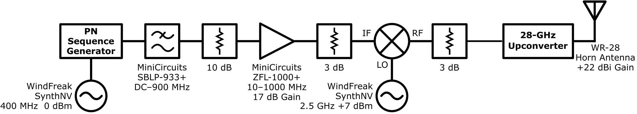
Tx Design

Slide 7
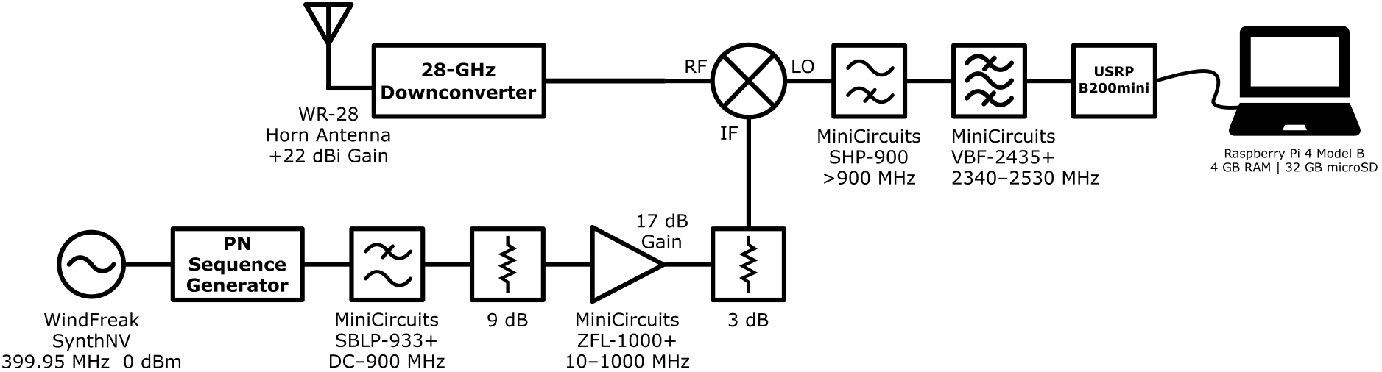
Rx Design

Slide 8
Operational Parameters
Parameter Name | Parameter Value (on-site)
Carrier Frequency | 28 GHz
Chip Sequence Length | 2047
RF Bandwidth | 800 MHz
Tx Chip Rate | 400 Mcps
Temporal Resolution | 2.5 ns
Rx Chip Rate | 399.95 Mcps
Tx/Rx Antenna Gain | 23 dBm
Measured Tx/Rx Azimuth HPBW | 10.1º
Measured Tx/Rx Elevation HPBW | 11.5º
Maximum Measurable Path Loss | 182 dB

Slide 9
Rx GNURadio Sink Parameters
A Raspberry-Pi host coupled with a USRP B200mini (TX/RX Channel)
Bandwidth = 0 Hz
Gain = 0 dB and 76 dB
Center Frequency = 2.5 GHz
Sample Rate = 2 Msps
QT GUI Time Sink: Dynamic limits & triggers for real-time visualizations over WLAN

Slide 10
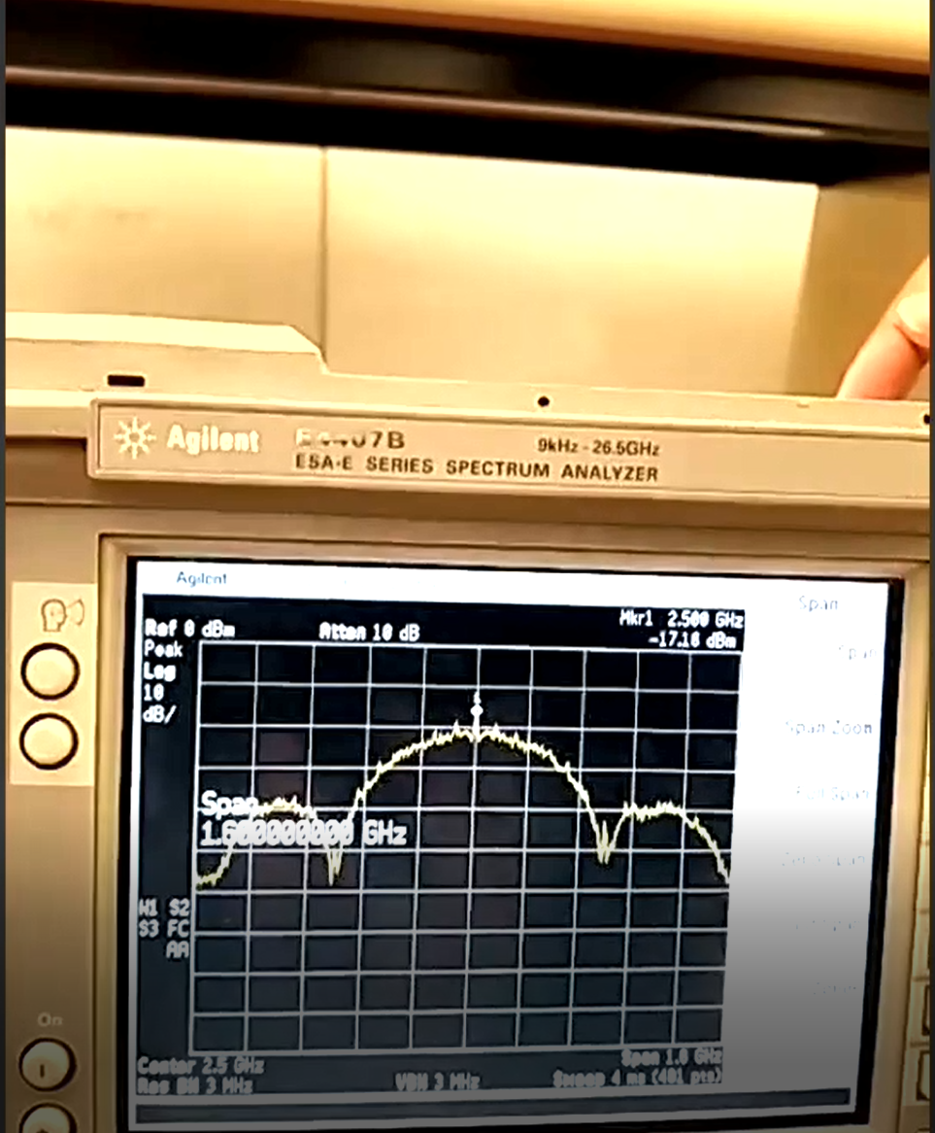
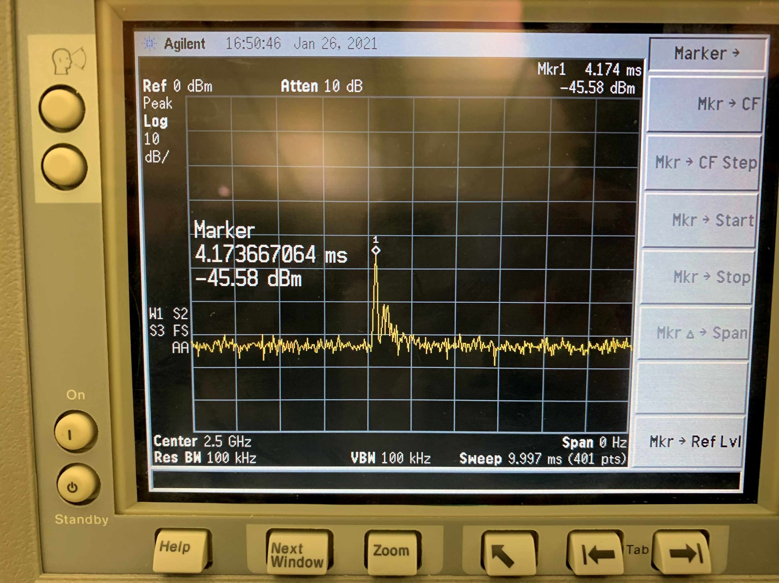
The signal observed at the input of the 28 GHz up-converter in the Tx circuit
The power-delay profiles observed in the Rx circuit (2.5 GHz swept at 10 ms)

Slide 11
The Autonomous Beam-Steering System

Slide 12
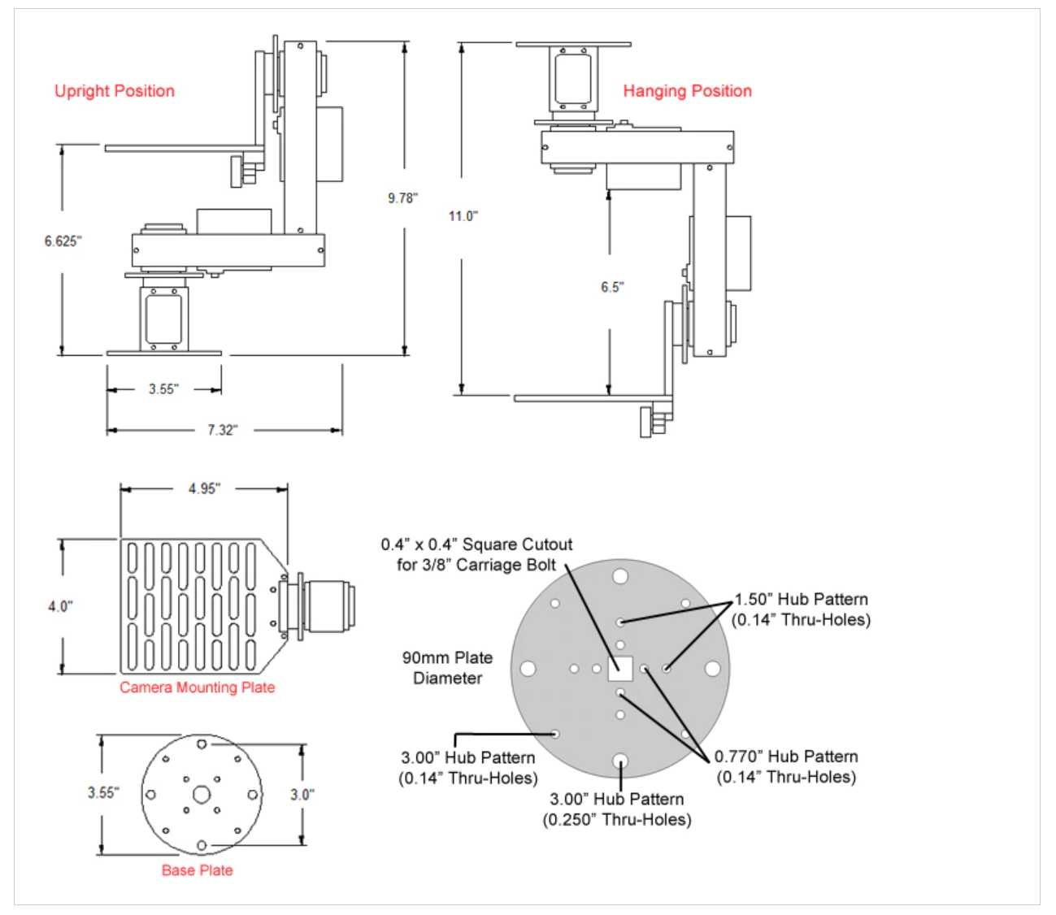
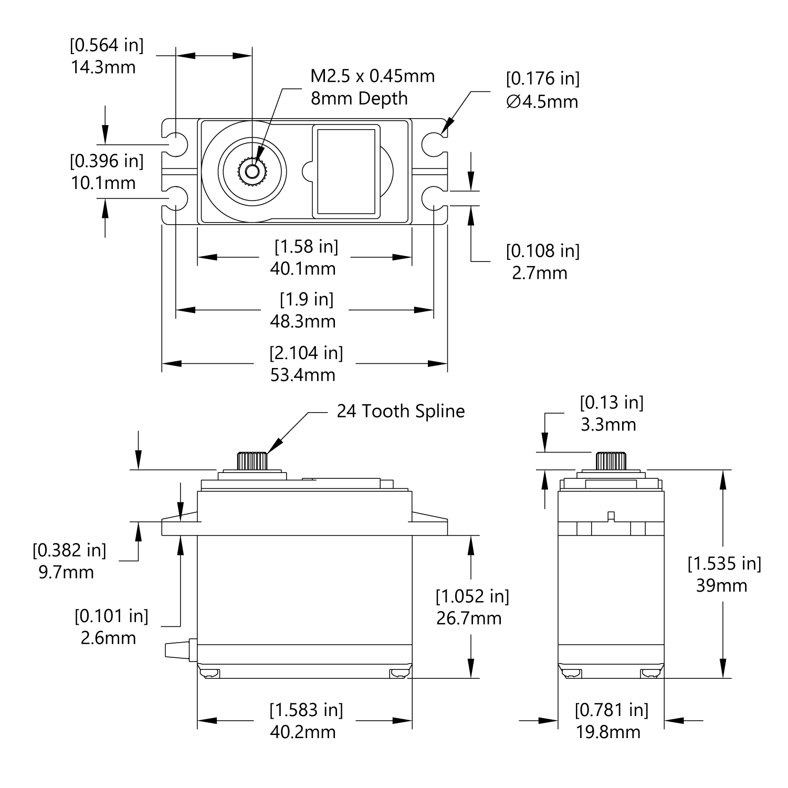
PT2645-S: Schematics
ServoCity PT2645-S Pan & Tilt Kit: Design Schematic
ServoCity HSR-2645CRH Servo: Design Schematic

Slide 13
PT2645-S: Design Parameters
Open-loop pan & tilt platform
Yaw and Pitch axes driven by an HSR-2645CRH continuous rotation servo
Gear ratio (both axes) is 7:1
12 teeth on the servo gear
84 teeth on the mount gear
5 lbs maximum payload

Slide 14
HSR-2645CRH Servo: Specifications
Parameter Name | Parameter Value
Output Shaft Style | C24T-Spline
Voltage Range | 4.8 – 7.4 V
No-Load Speed (4.8 V) | 46 rpm
Stall Torque (4.8 V) | 111.09 oz-in (8 kg-cm)
Pulse Amplitude | 3 – 5 V
Direction with Increasing PWM Signal | Clockwise
Feedback Style | No positional feedback (open-loop continuous rotation servo)
Output Shaft Support | Dual Ball Bearings
Weight | 1.87 oz (53 g)
Motor Type | Carbon Brushed Cored Motor

Slide 15
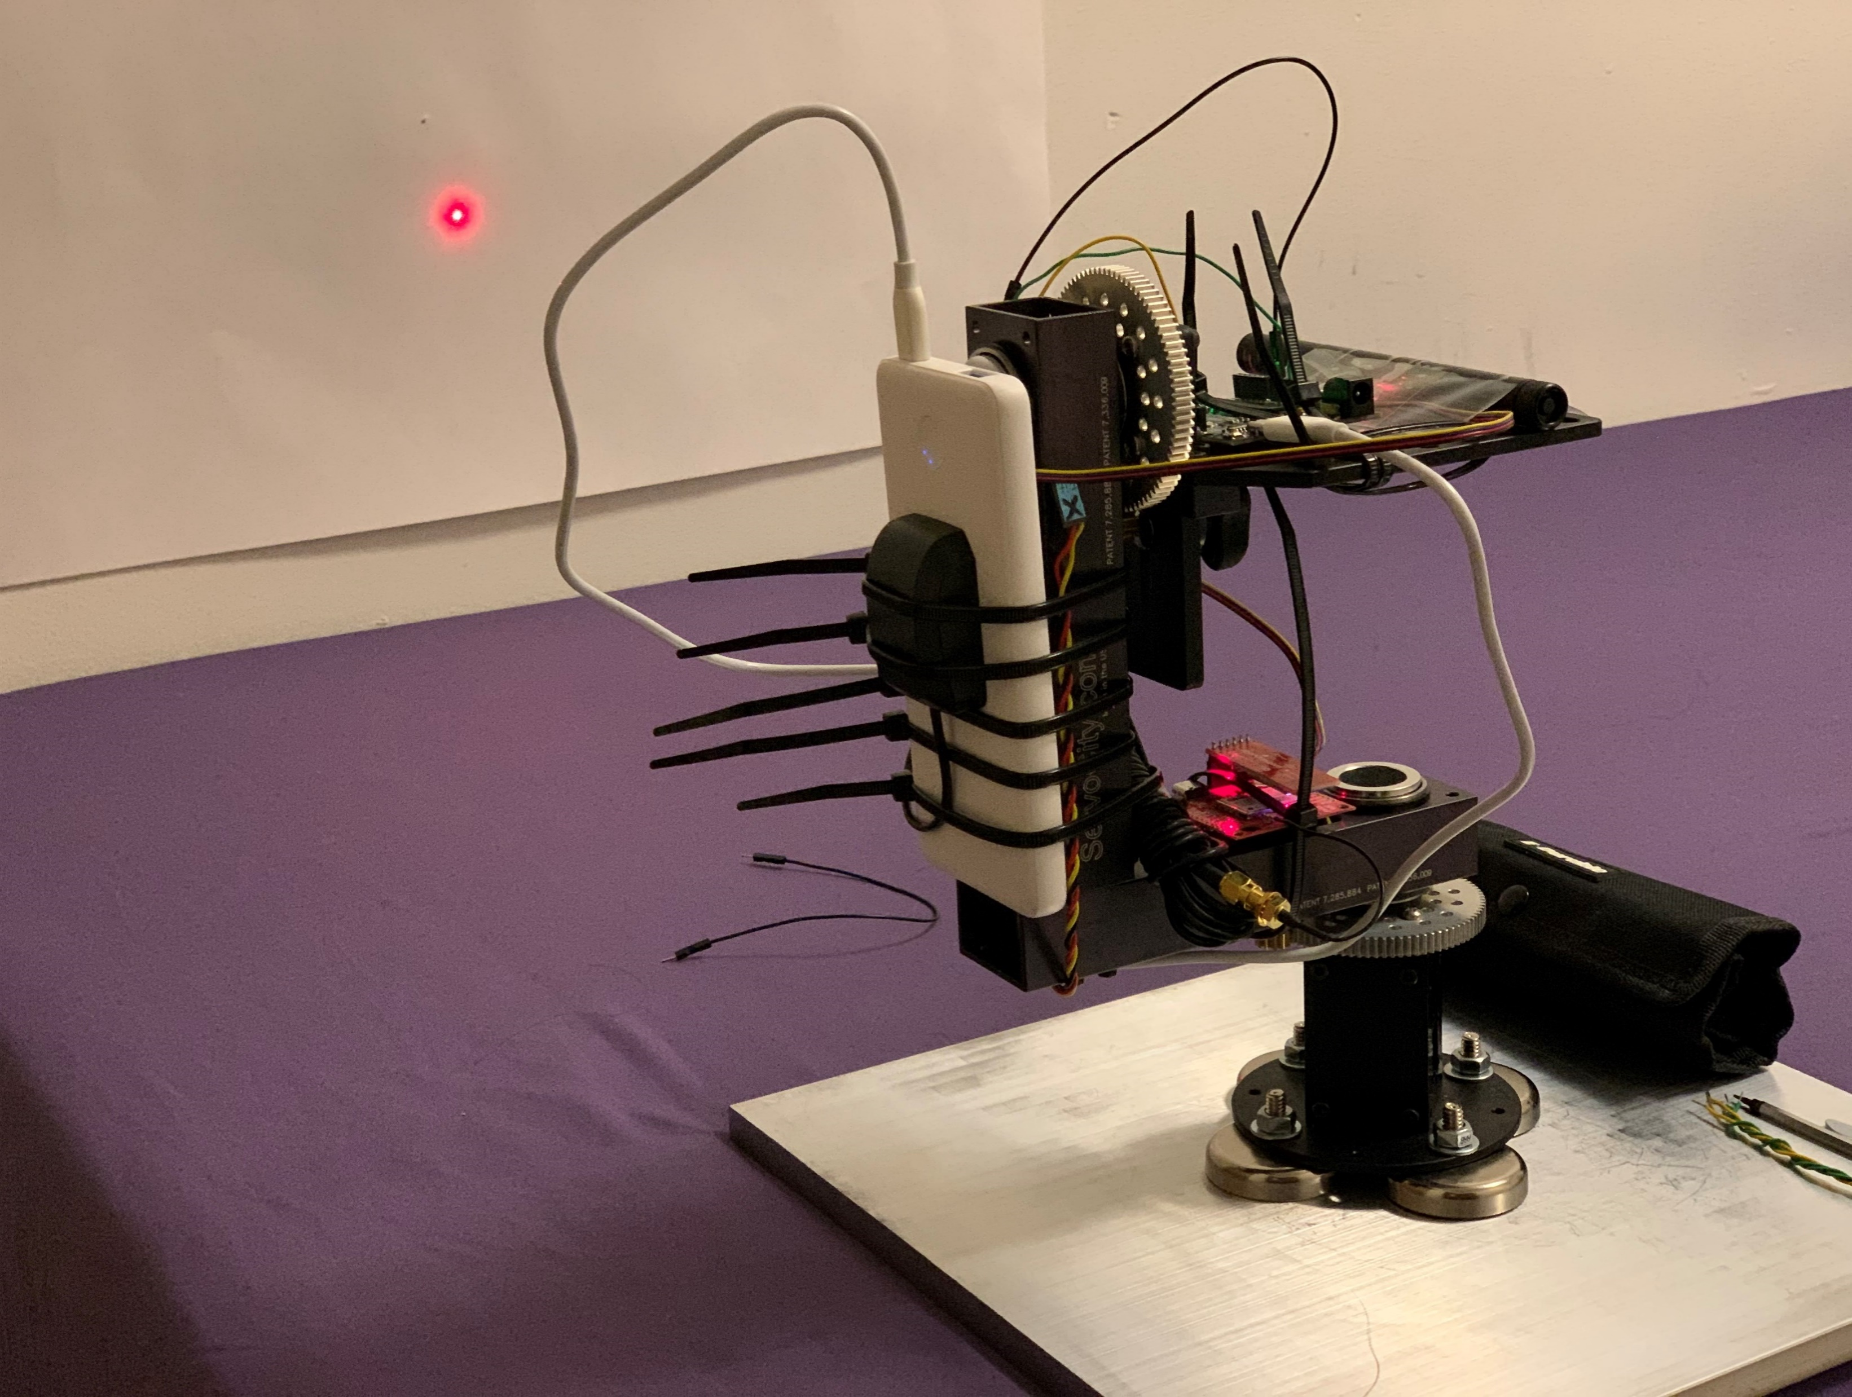
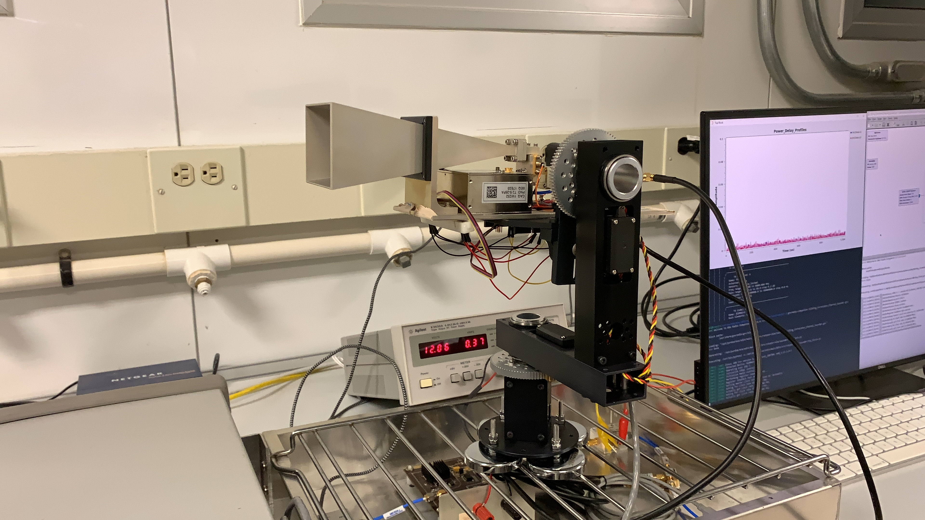
Rotational Platform Testing: Laser Testbed | Image Recognition
Rotational Platform + Communication System: Laboratory Testing Setup

Slide 16
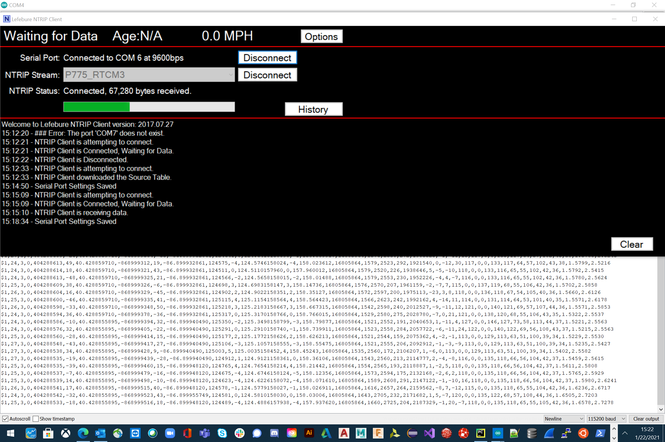
GPS Translation: UBlox GPS messages (with RTCM3.0 corrections) over I2C → Internal NMEA format over Serial → JSON events streamed over Kafka

Slide 17
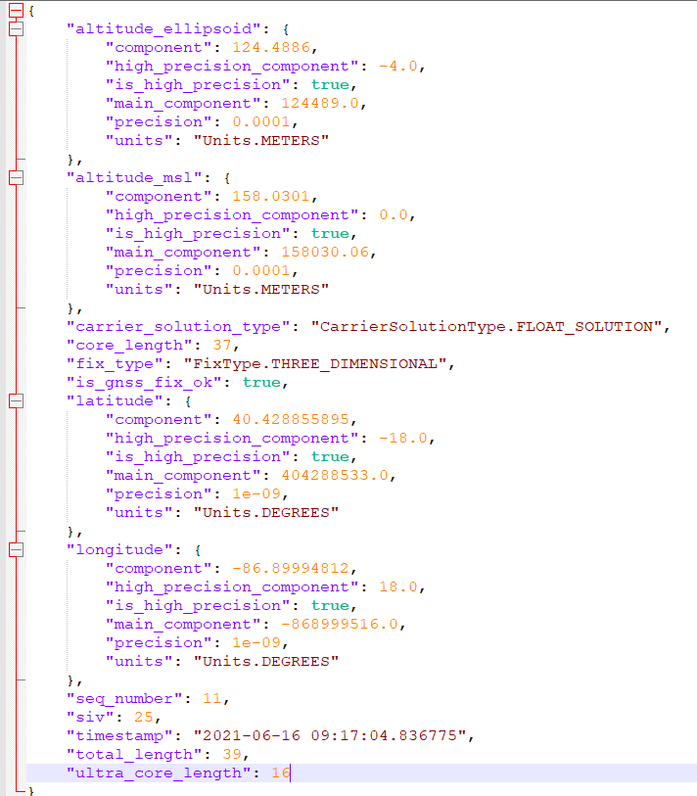
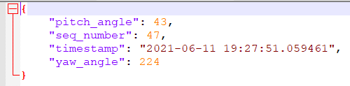
IMU Event Sample
(logged internally for post-processing)
JSON GPS Event Sample
(streamed over Kafka for Tx/Rx alignment)

Slide 18
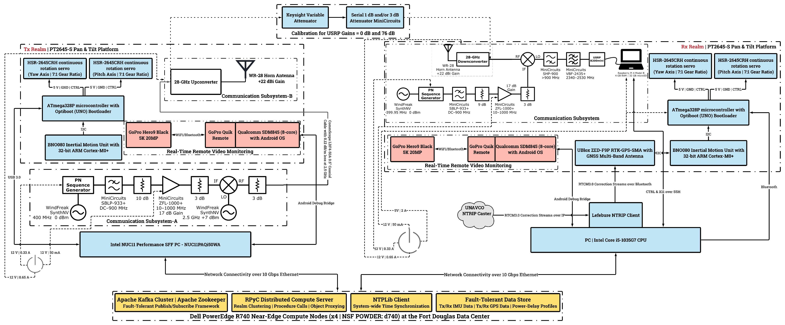
The Complete System Architecture

Slide 19
Pre-Deployment Calibration

Slide 20
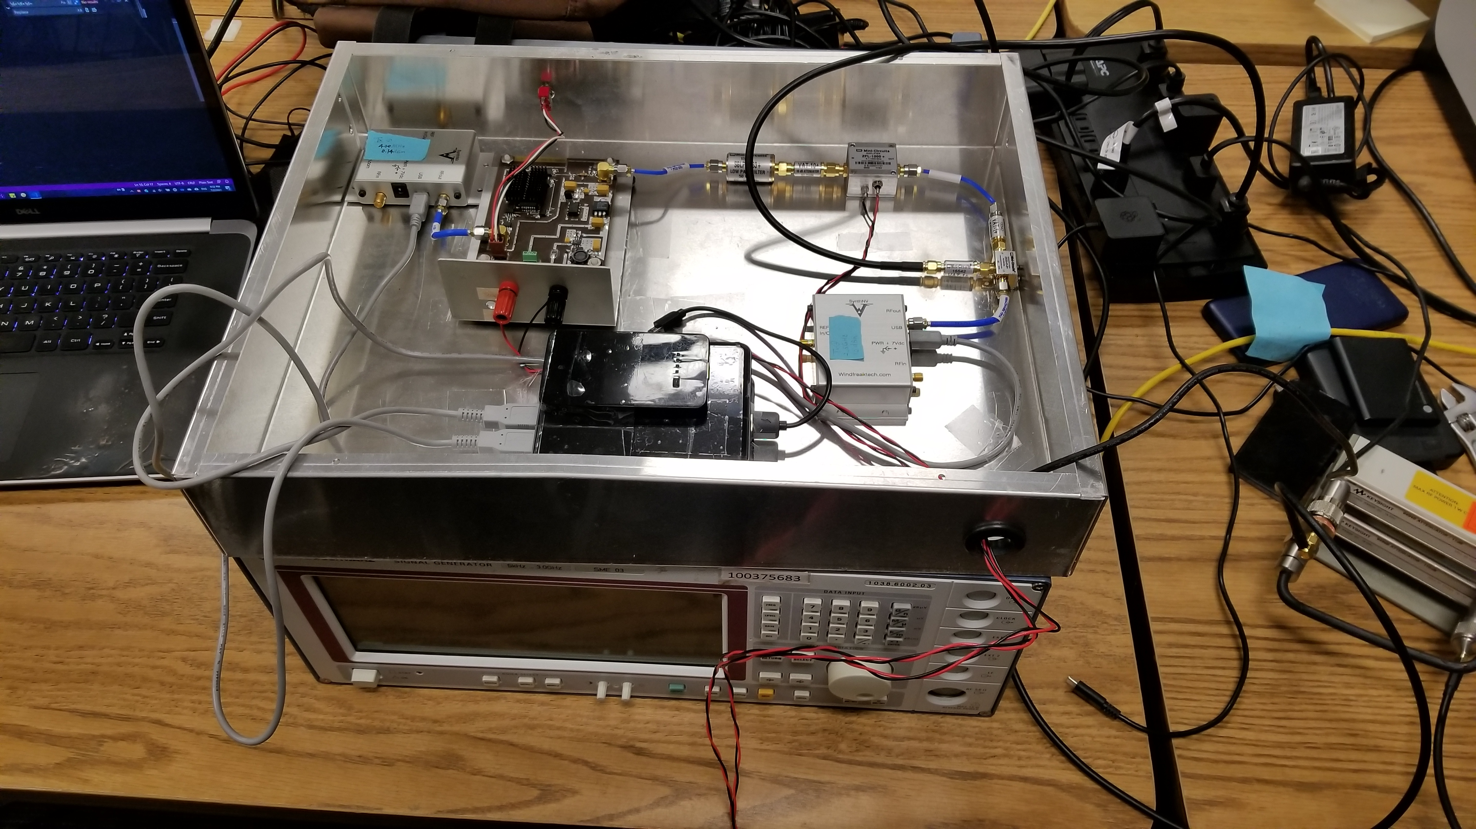
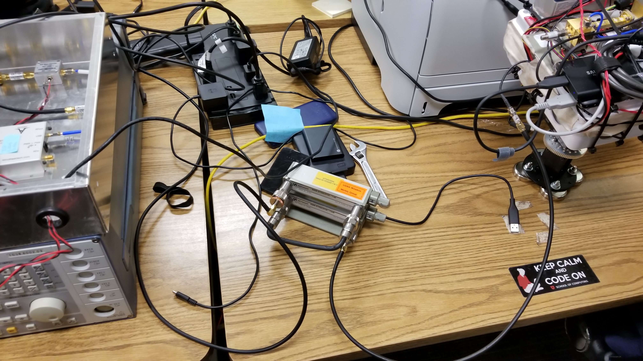
Pre-Deployment Calibration Setup: Tx
Pre-Deployment Calibration Setup: Variable Attenuator + Rx

Slide 21
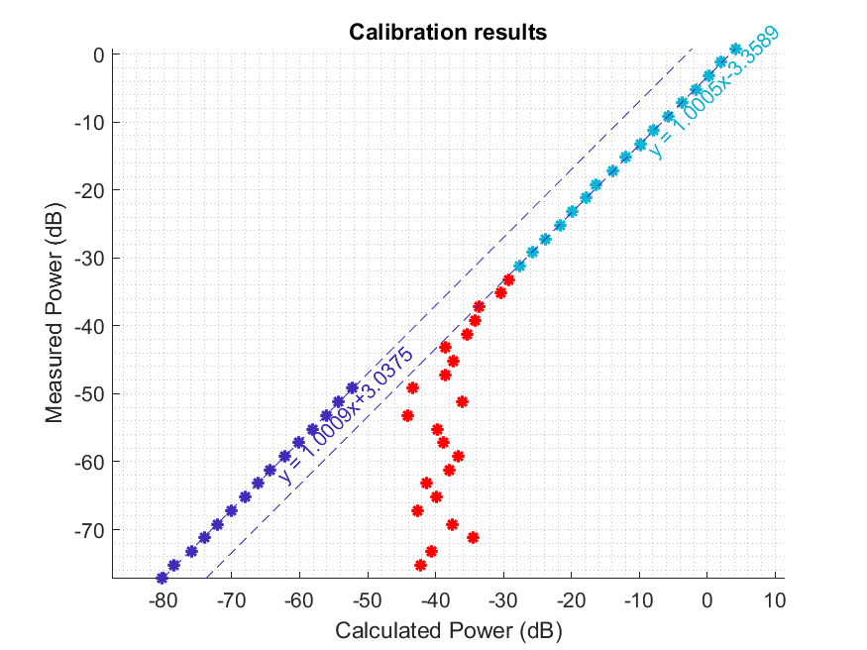

Slide 22
On-Site Deployment

Slide 23
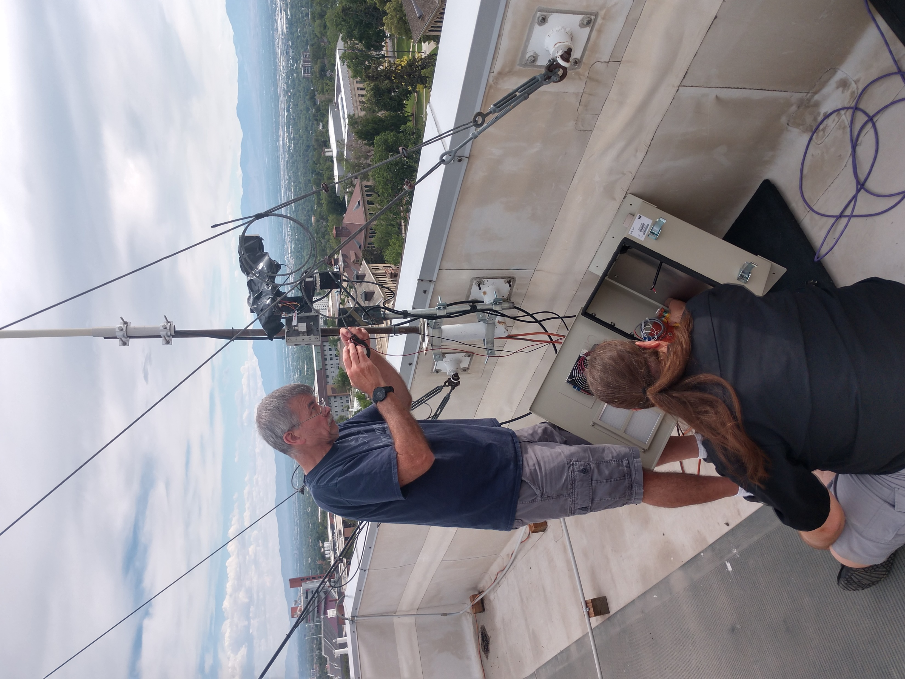
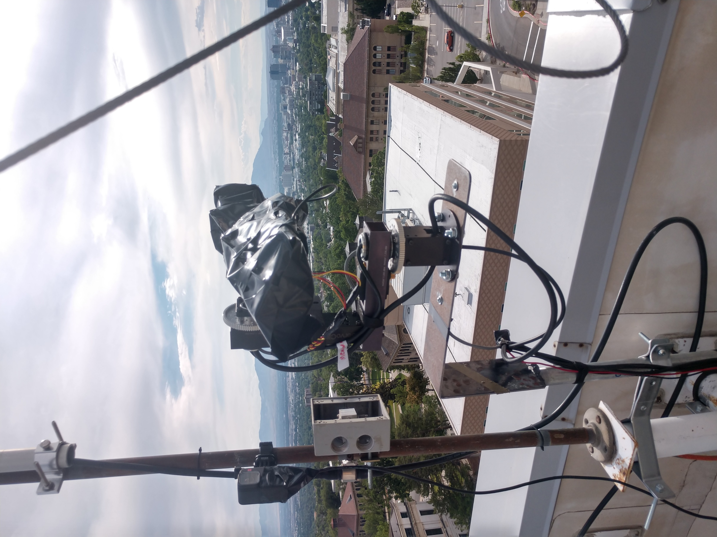
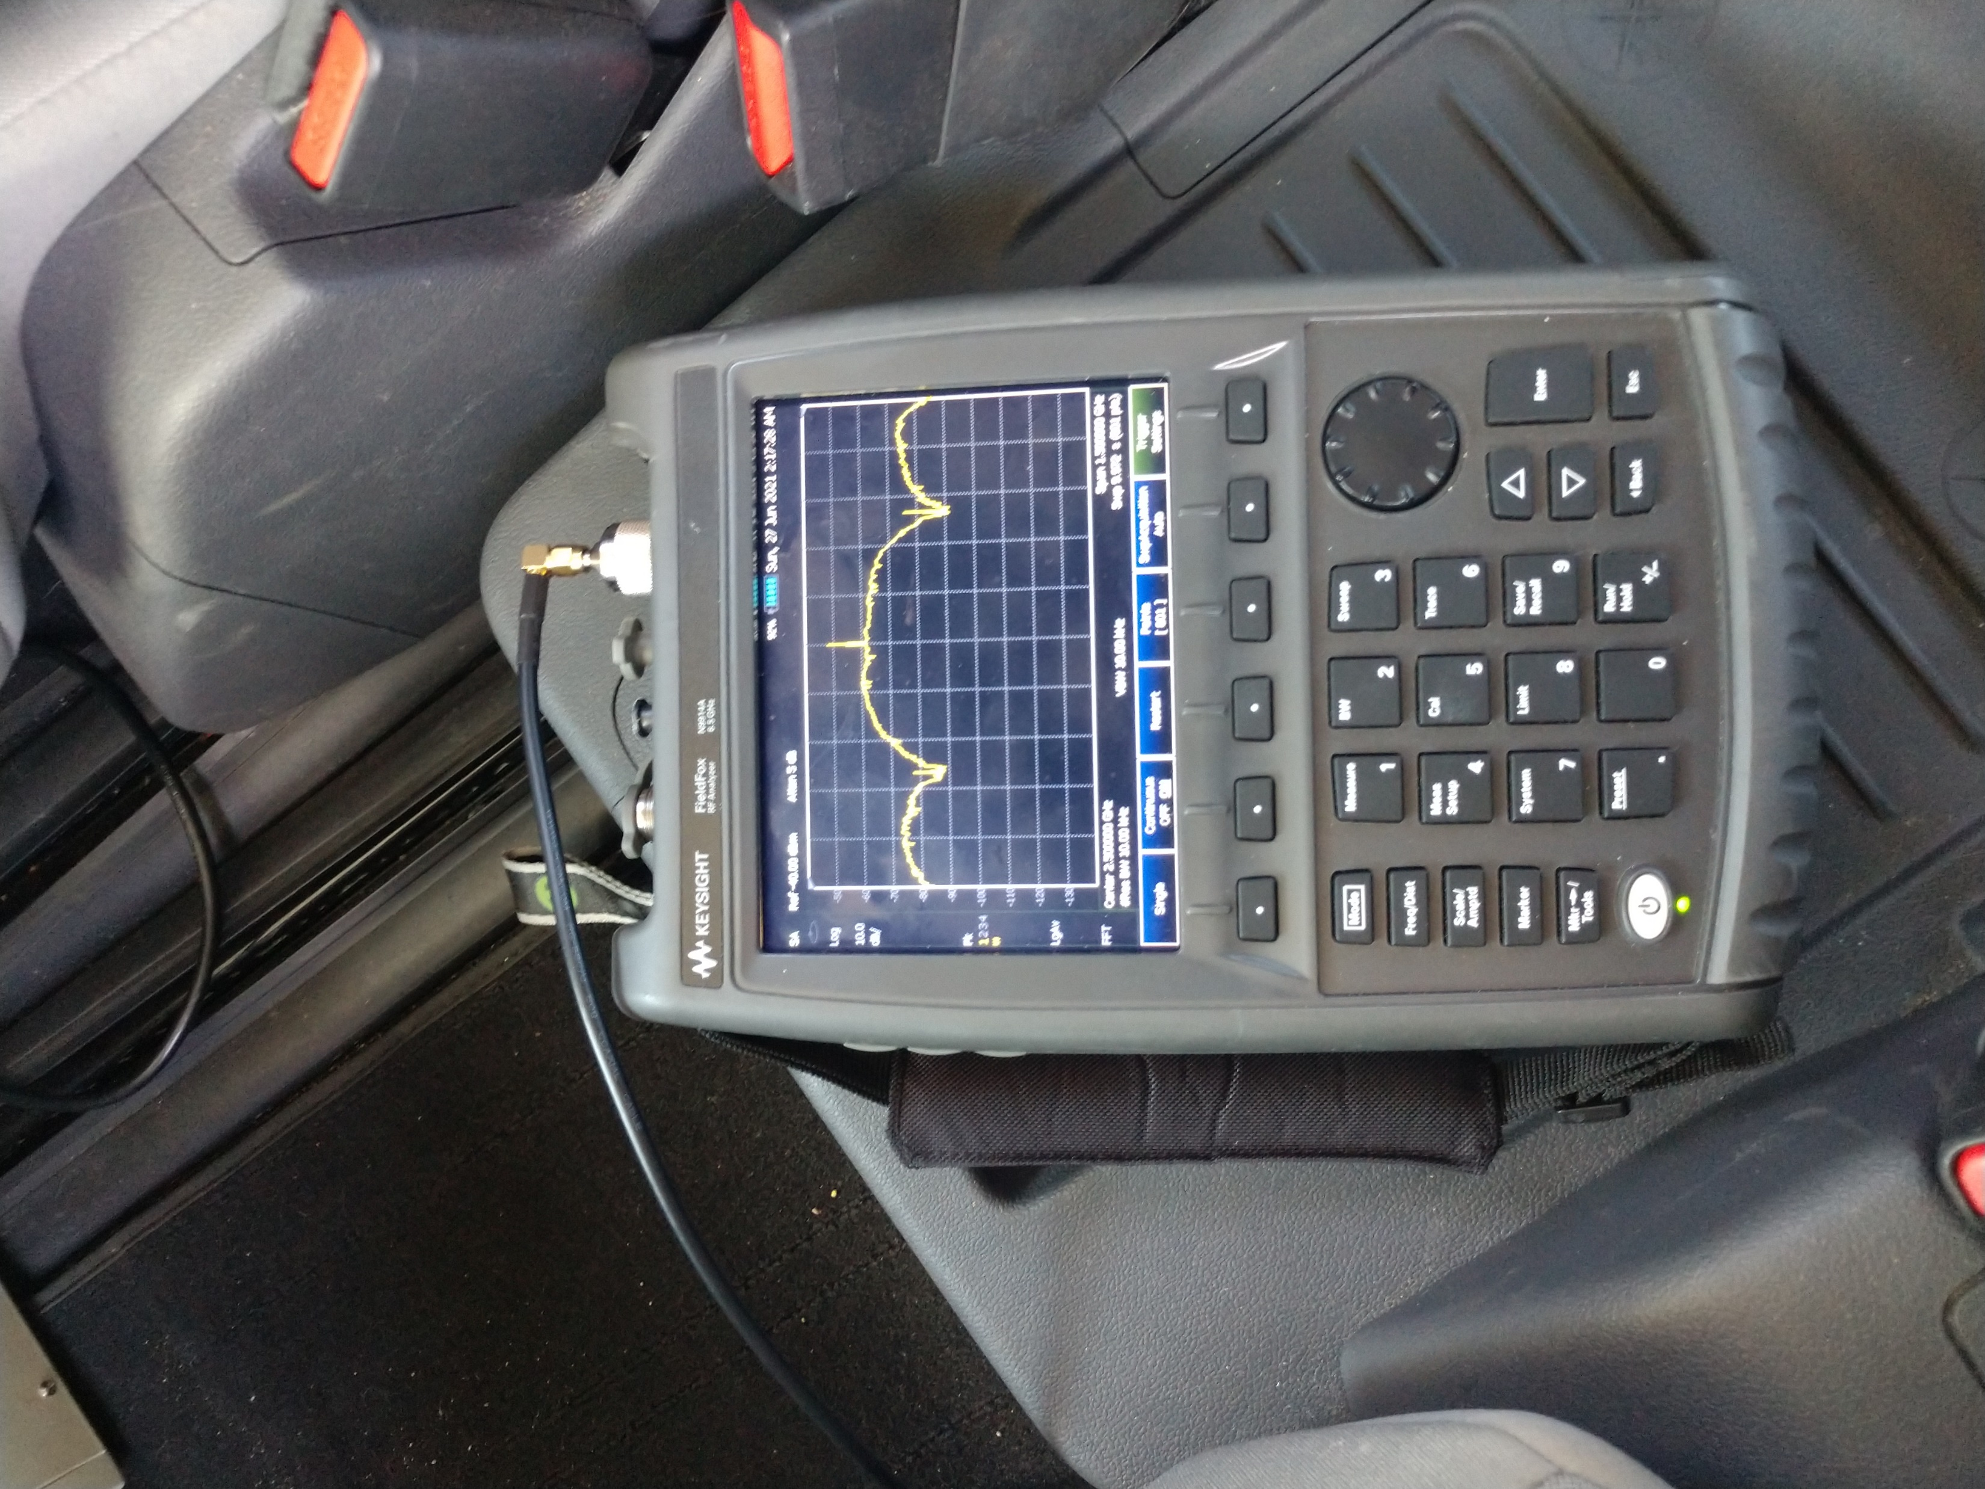
Tx Installation and Testing: Rooftop mount | Weather-proofing | Signal tests on a handheld spectrum analyzer

Slide 24
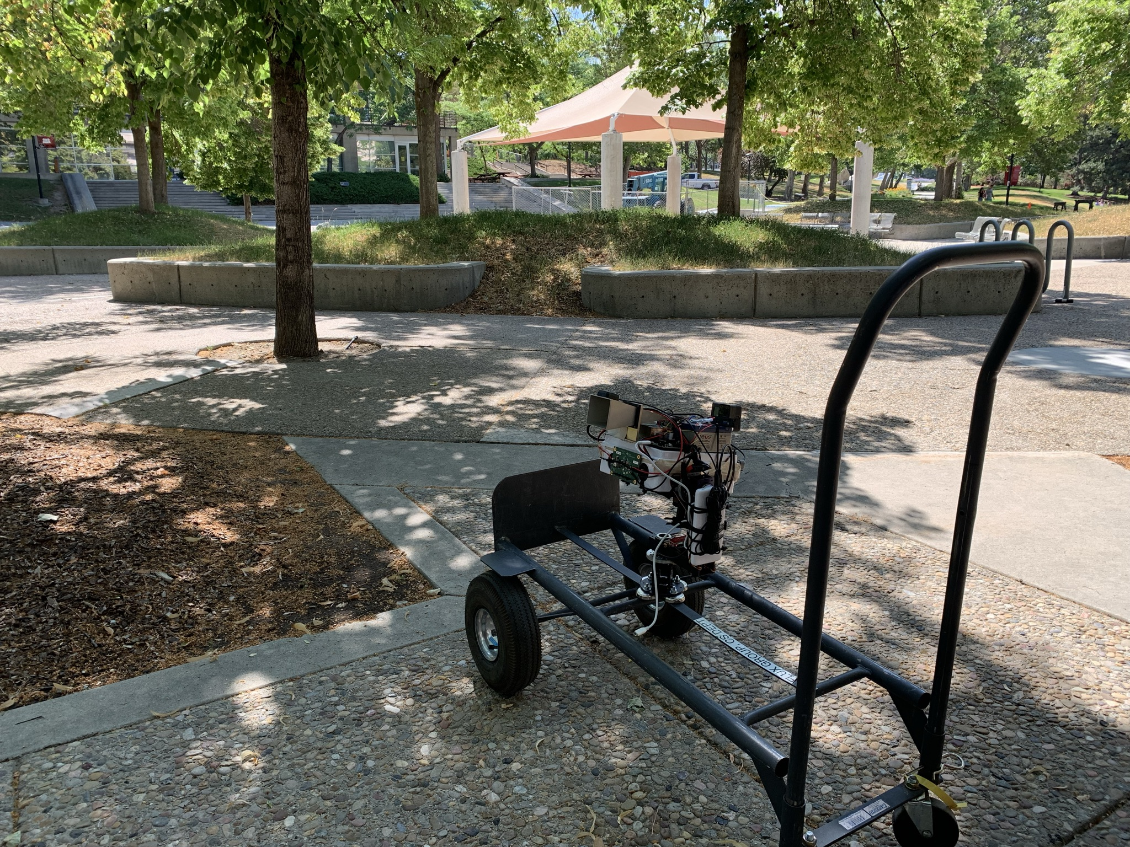
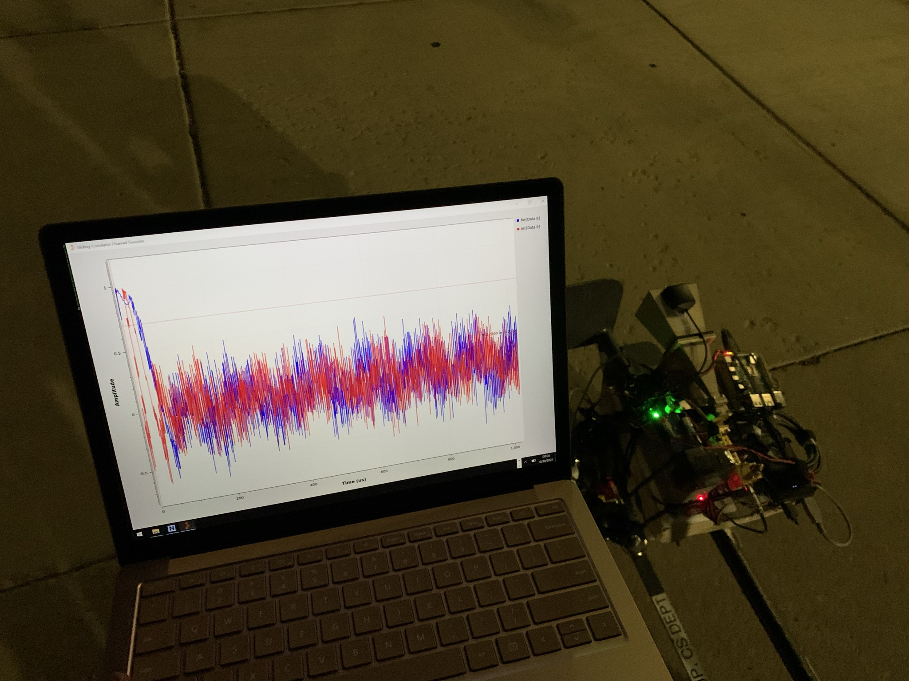
Rx Deployment and Data Collection: Installation on a cart (urban-vegetation) | Real-time visualization of power-delay-profile samples

Slide 25
Platform Features & Results

Slide 26
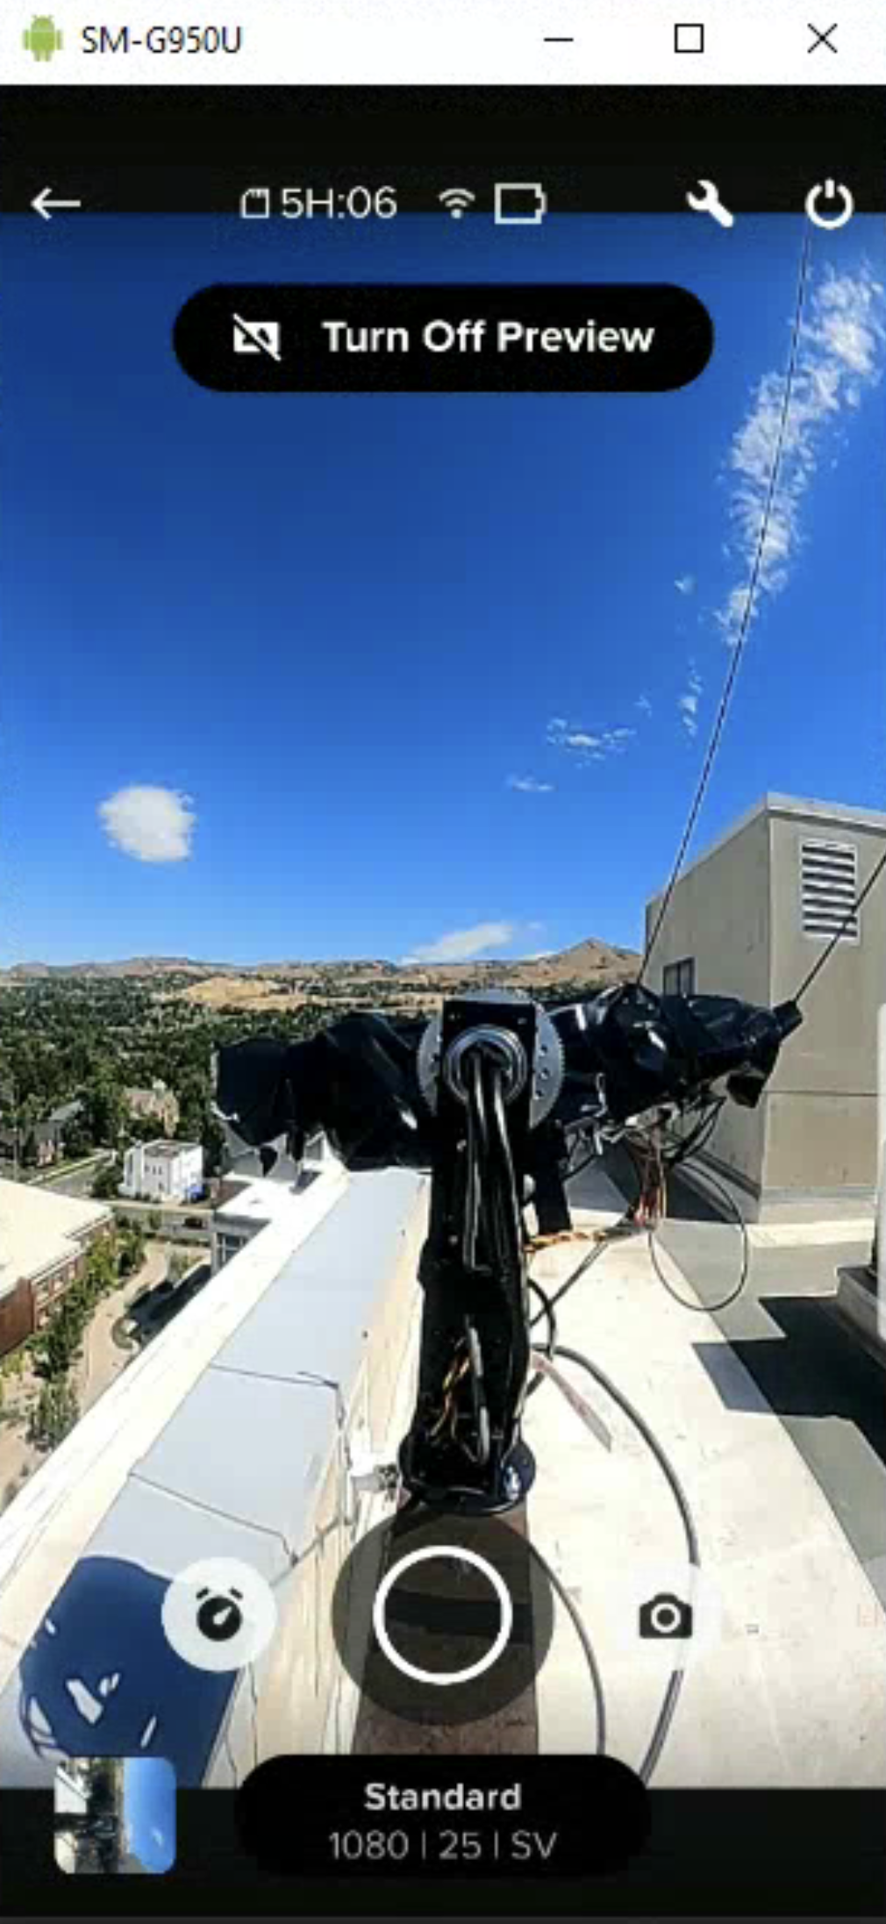
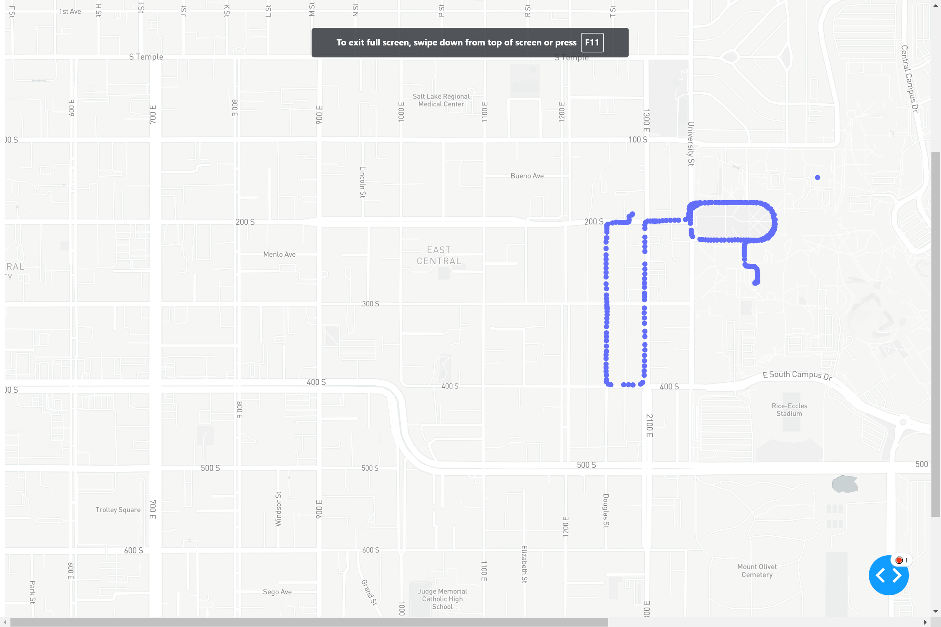
Fixed Tx location
Rx route visualized in Plotly-Dash/MapBox as it is being traversed
Real-time Orchestration: Tx monitoring & troubleshooting via an Android Debug Bridge | Rx route visualizations

Slide 27
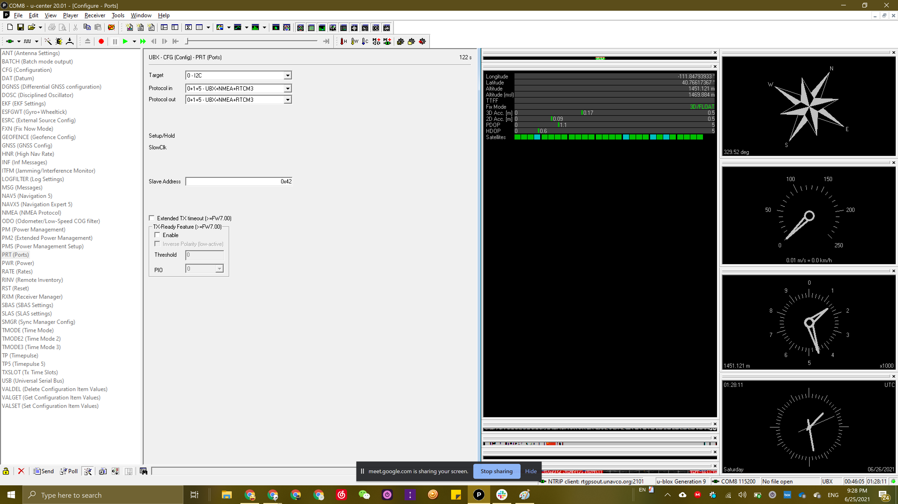
Geo-positioning Accuracy on-site: 2-D accuracy of 9 cm & 3-D accuracy of 17 cm – with RTCM3.0 and 28 satellites-in-view

Slide 28
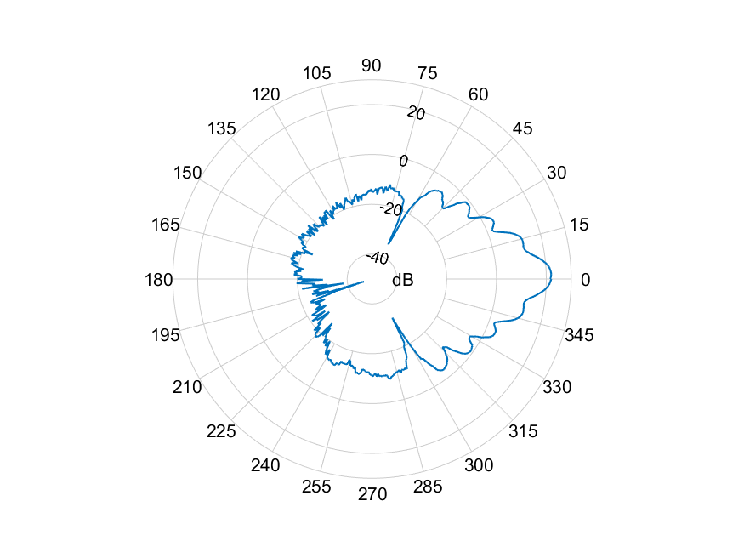
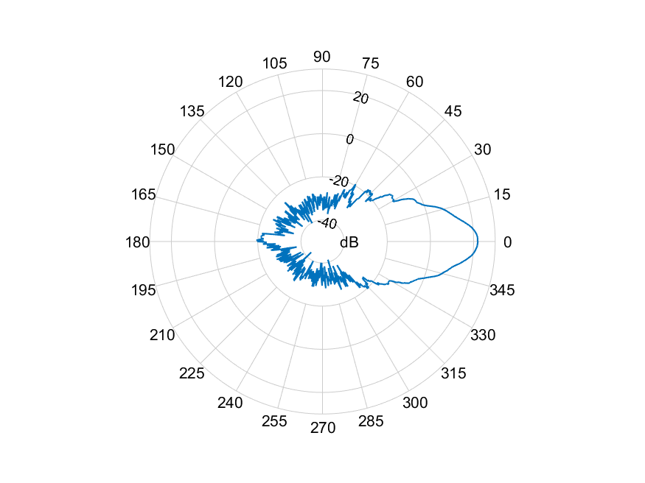
Antenna Pattern: Azimuth
Antenna Pattern: Elevation

Slide 29
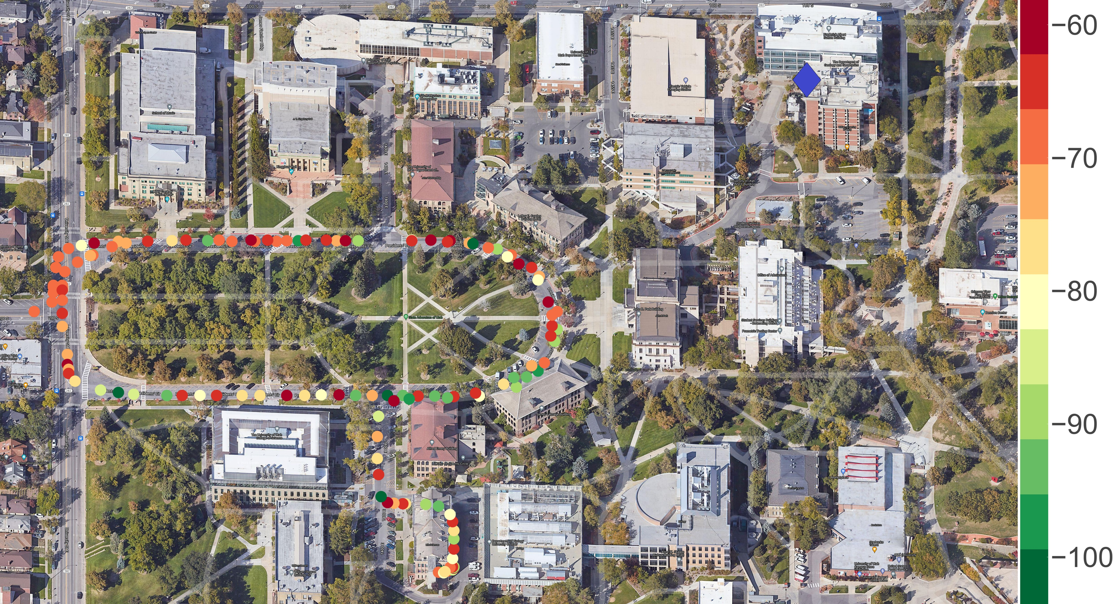
Post-Processing: Received signal power values superimposed on a Google Hybrid map of the site under analysis – President’s Circle (urban)

Slide 30
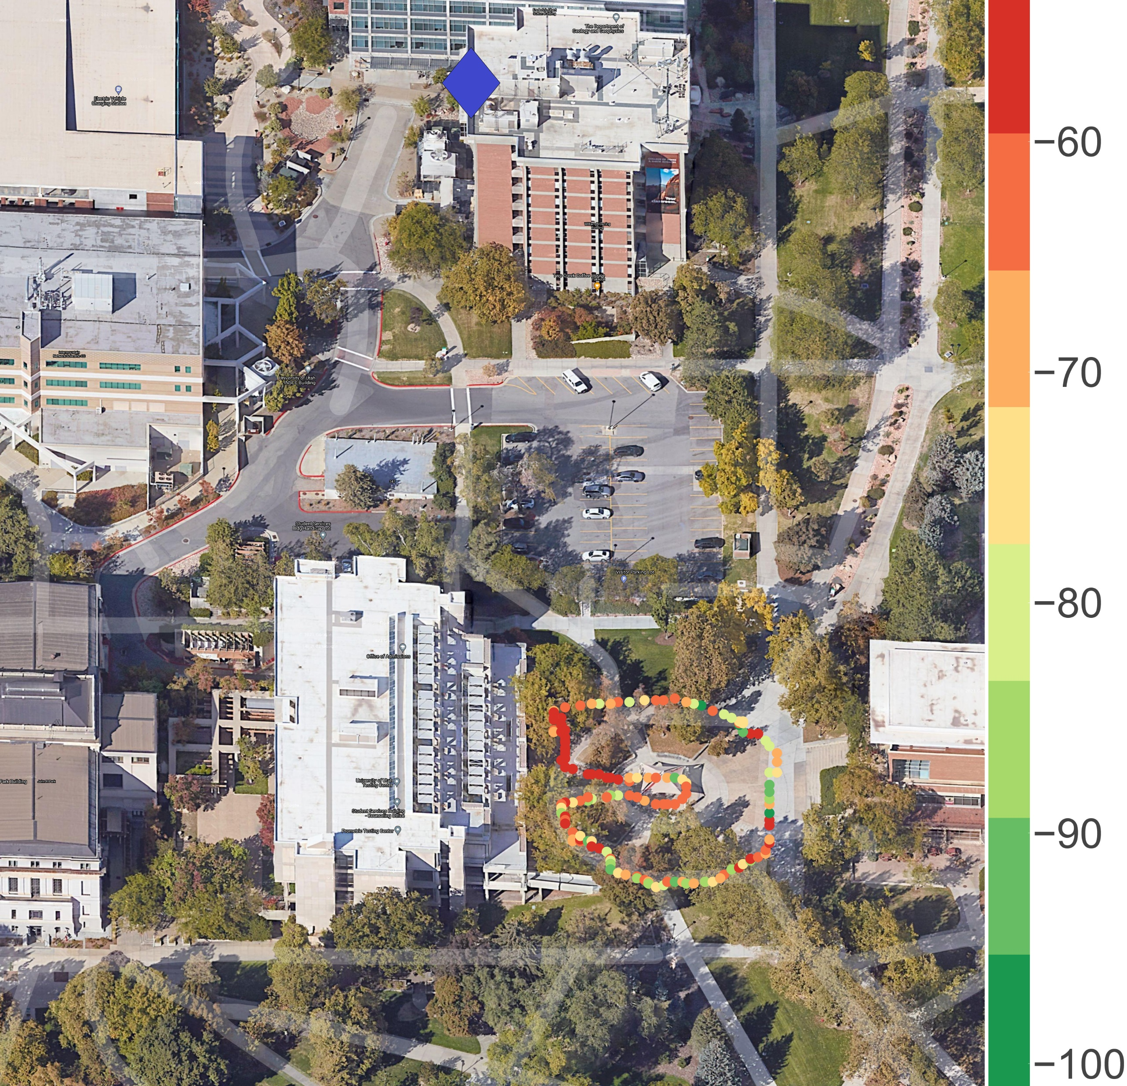
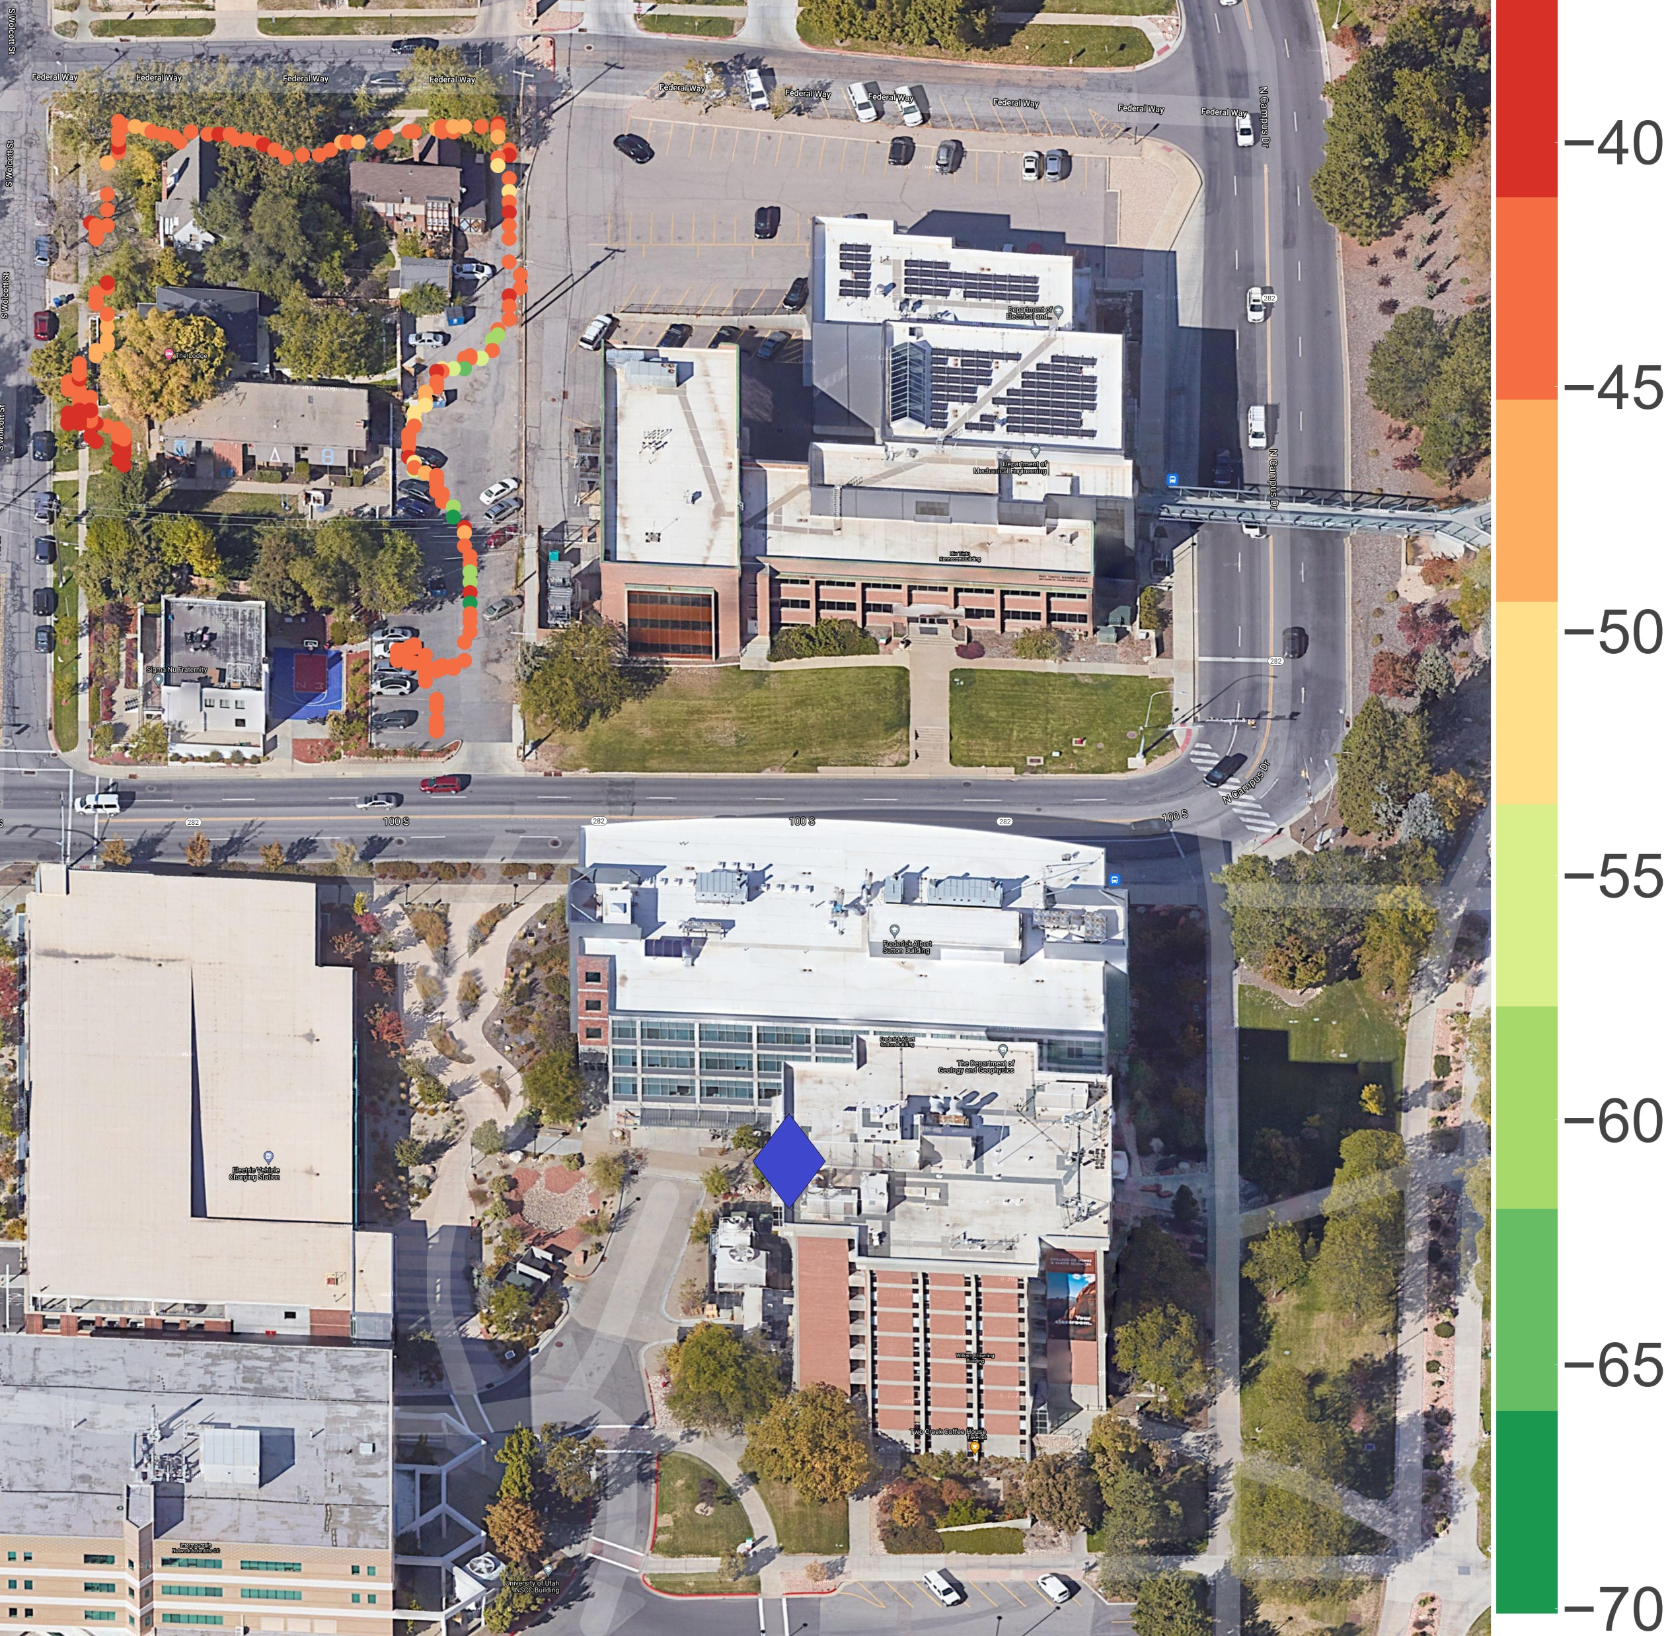
Post-Processing: Received signal power values superimposed on a Google Hybrid map of the sites under analysis –
Campus Vegetation/Foliage (urban) and Campus Fraternities (suburban)

Slide 31
Thank you

Slide 32
Q & A

